Slide 1

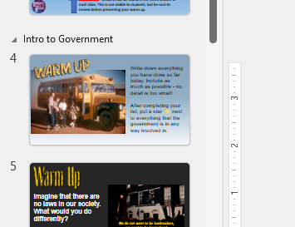
Thank you for purchasing this resource!
Note: I very much appreciate your support, however please do not share this presentation or post it online. This allows ANY student in the world to access the included answer key. You can access a Google Slides version of this file here to use digitally:
https://docs.google.com/presentation/d/17OC8PwCX5t0Vhe-Uj39pCL2jfpazCEvKTZIRiurJUzI/copy
I start each class day of the year with one of these slides and give students 5 minutes to complete it in their notebook as I take attendance. We then review their answers together to connect to the previous day’s lesson. I then move on to what we are covering that day from the discussion we had in the warm up.
You can see in the navigation portion the units that each set of slides fits into.

Slide 2
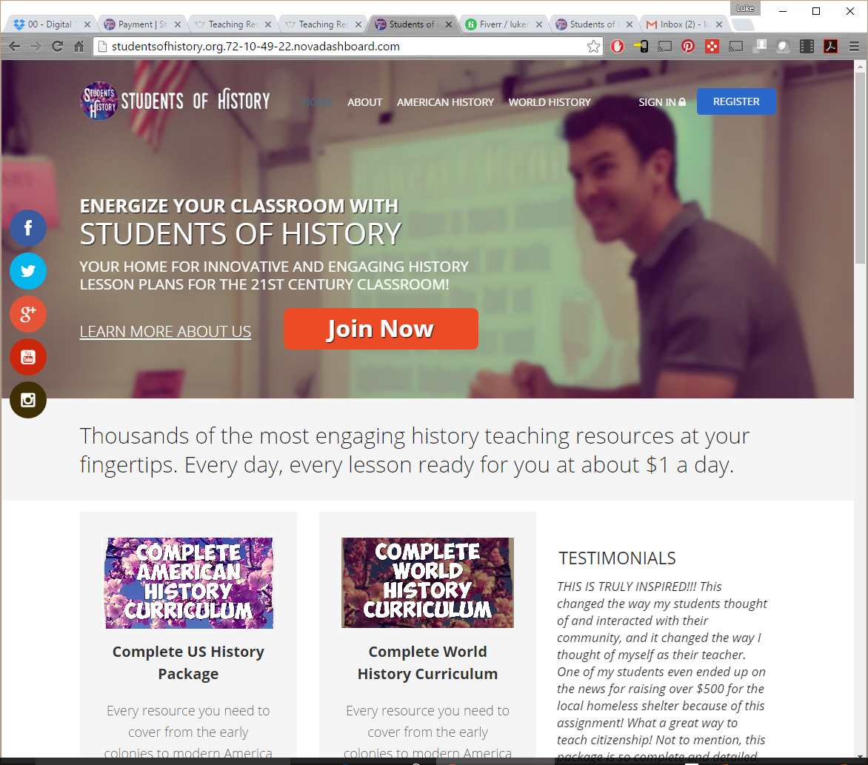
Now you can get access to EVERY RESOURCE for World or US History through a subscription! That’s over 600 amazing resources like interactive notebooks, Google Drive notebooks, warm ups, projects, PowerPoints and more! Plus lesson plans for how to best use the resources every day. They’re all available at StudentsofHistory.com!
Every resource in my TpT store at your fingertips for 1 low price!!!
Learn more here: https://StudentsofHistory.com

Slide 3
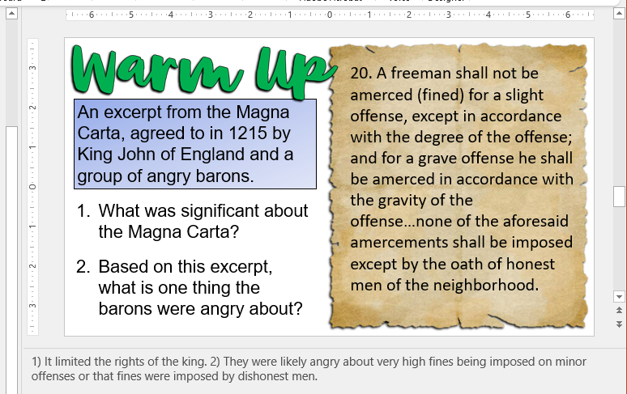


Answer Key – answers can be found in the notes section of each slide. This is not visible to students, but be sure to review before presenting your warm up.

Slide 4

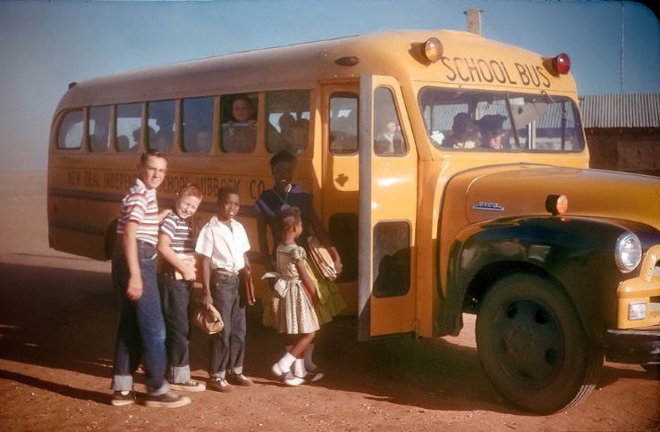
Write down everything you have done so far today. Include as much as possible - no detail is too small!
After completing your list, put a star ⭐ next to everything that the government is in any way involved in.
Notes:
Obviously, student responses to this will vary quite a bit. Allow students to share some of their list briefly and then go through those that they starred. You can then discuss how almost everything we do somehow involves the government (food regulation in regard to breakfast, transportation & traffic laws, school, taxes on the clothes they purchased, etc).
Image: Lubbock, Texas 1957. Wikimedia.

Slide 5

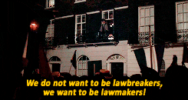
Imagine that there are no laws in our society. What would you do differently?
What does “the right thing to do” mean?
Notes:
This question should lead the class into a discussion on why follow the law, what does "the right thing to do" mean? The important conclusion students should gather from this is that laws are supposed to follow our collective values and allow us to feel safe."

Slide 6

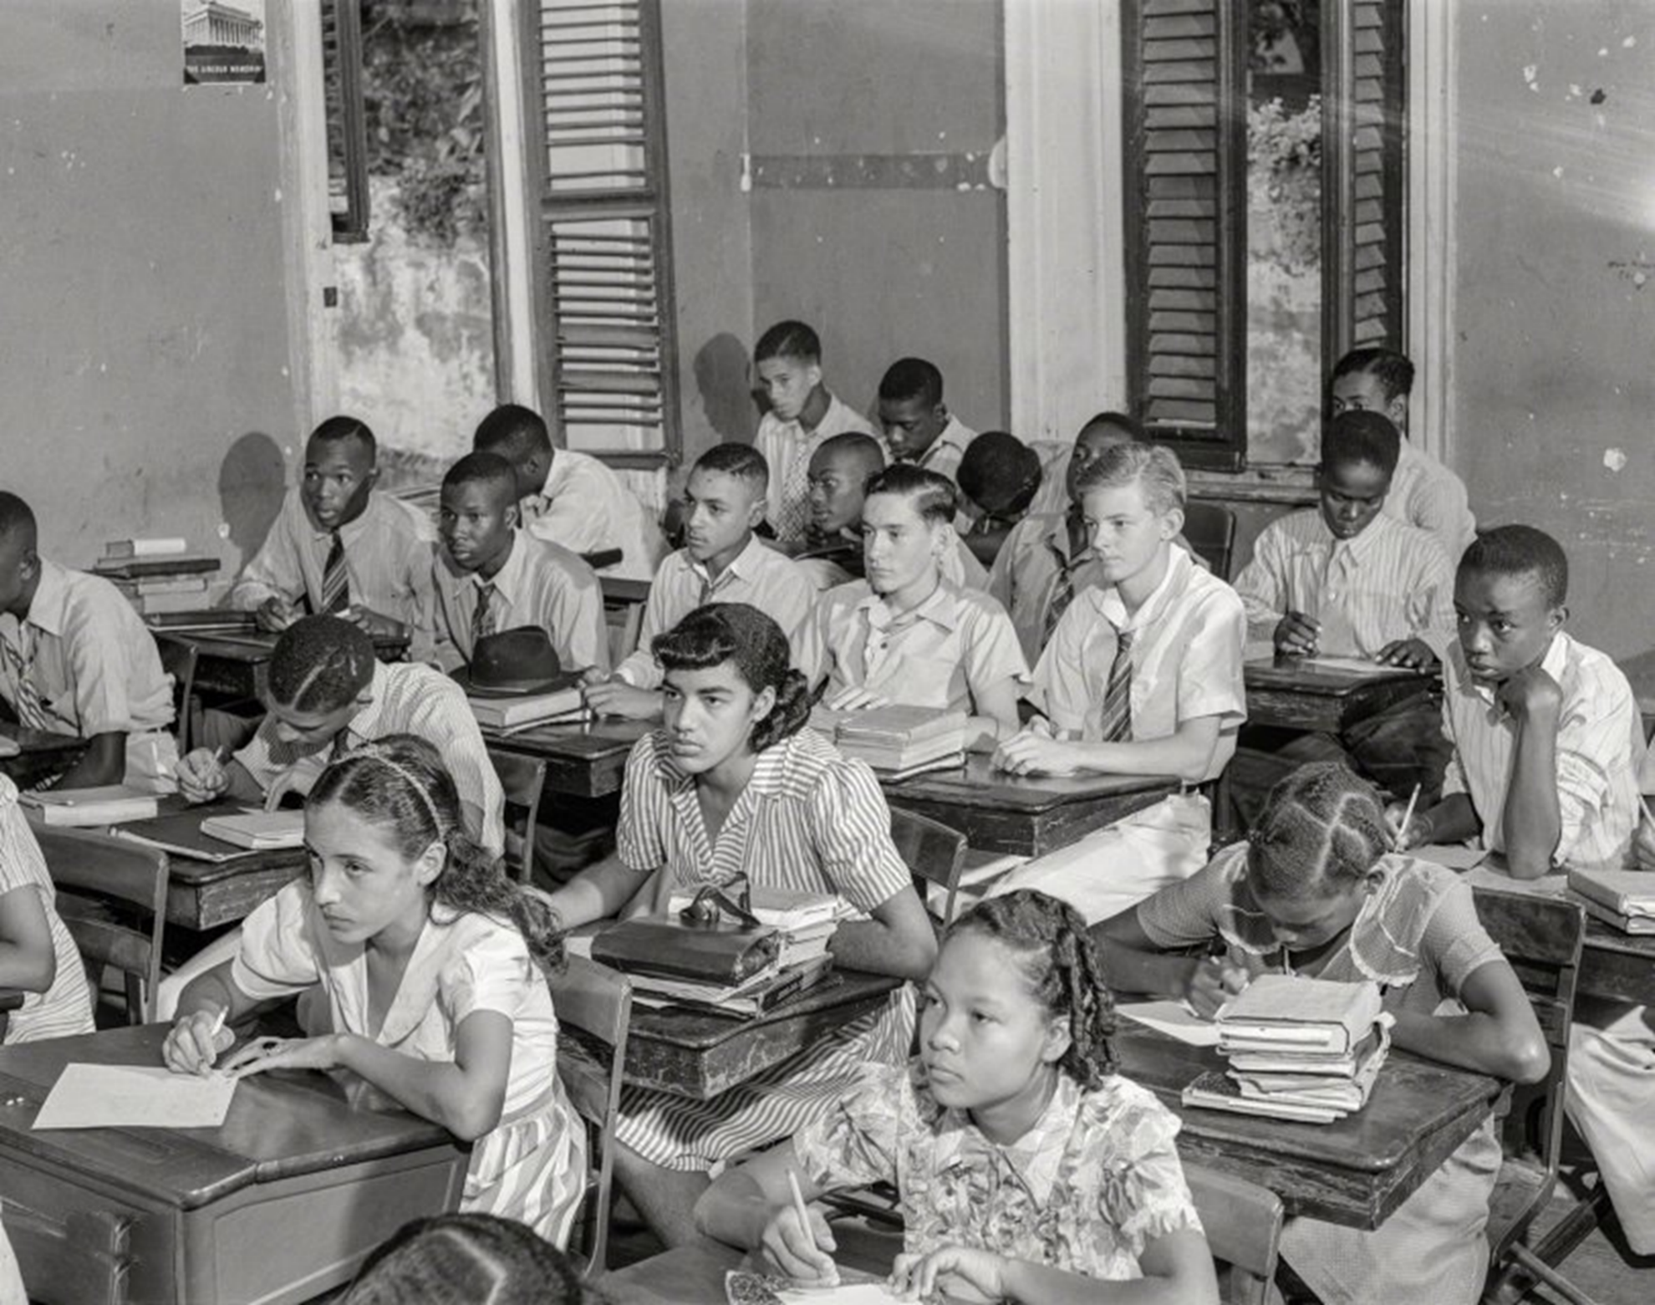

In what ways is our school like a dictatorship and in what ways is it a democracy?
Notes:
Answers will clearly vary. Many students usually have an idea about democracies and dictatorships when they enter my classes, however the finer details are usually a little fuzzy. This question usually gets the kids fired up to complain about various school rules and our discussion going on the differences between various forms of government.
Image: Christiansted High School, Saint Croix, U.S. Virgin Islands. December 1941.

Slide 7


Autocracy
Oligarchy
Dictatorship
Democracy
Match each definition to its form of government.
Government in which the power to rule is held by a small usually self-appointed elite
Government is conducted only by consent of the people
Absolute and unchallengeable authority over people
Government which a single person holds unlimited political power
Notes:
1) B, 2) D, 3) C, 4) A

Slide 8

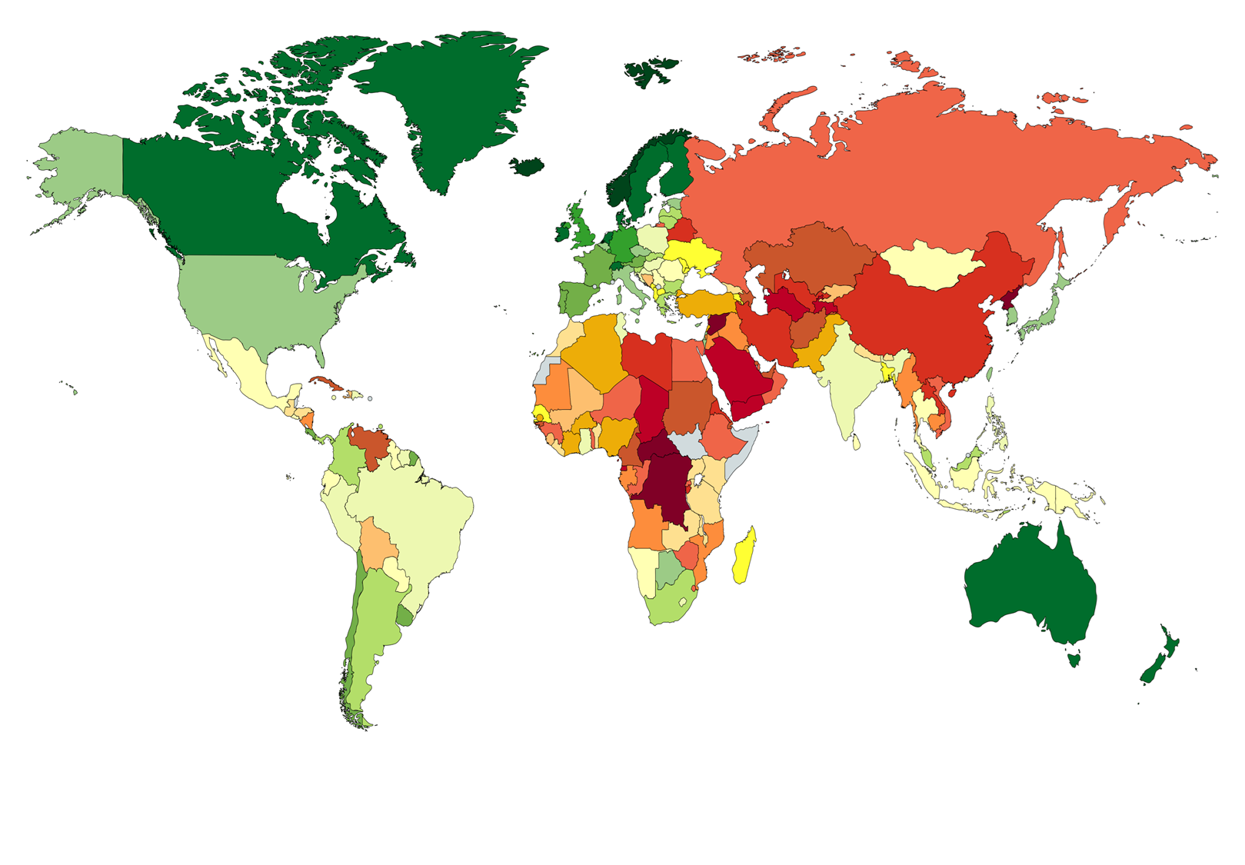
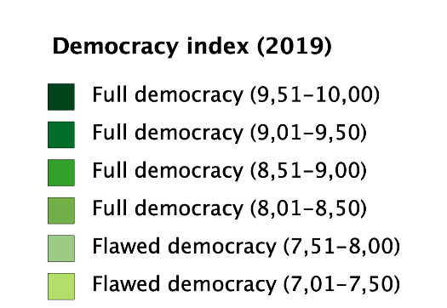
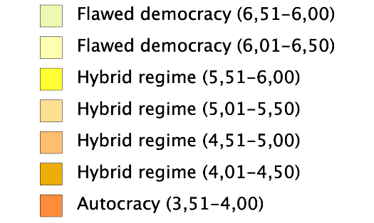
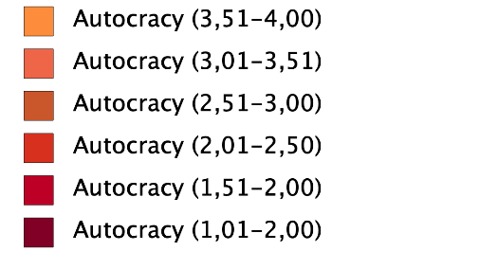
What are some ways a democracy can be “flawed”?
Why do you think some regions suffer under more autocracies and hybrid regimes?
Notes:
1) Answers will vary but can include government corruption, inefficiency, lack of a free press, manipulation of public opinion and propaganda, etc. 2) Answers will vary but they could note that countries in Africa have had less time as independent nations with most only gaining independence sin the 1960s. The history of the communist Soviet Union and China’s influence on Asia and the Middle East hurt those areas as well.

Slide 9

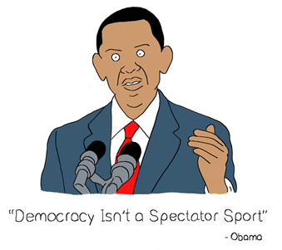
What do you think is necessary in a country for democracy to survive?
Notes:
Answers will vary and can include: education, free and fair elections, citizens who are active in civic life, the rule of law, a multi-party system, and more…

Slide 10
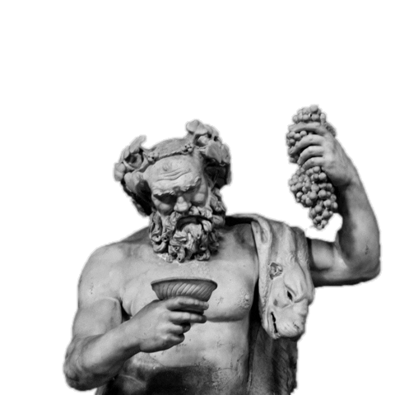

What forms of government existed in Ancient Greece and Rome?
What aspects of these are still found today?
Notes:
1) I assume most students will have taken World History and (hopefully) remember democracy in Athens and the Roman Republic. That can hopefully lead to a brief class discussion about Ancient Athens and Rome's later Republic. 2) Voting and representatives for the people are still used.

Slide 11
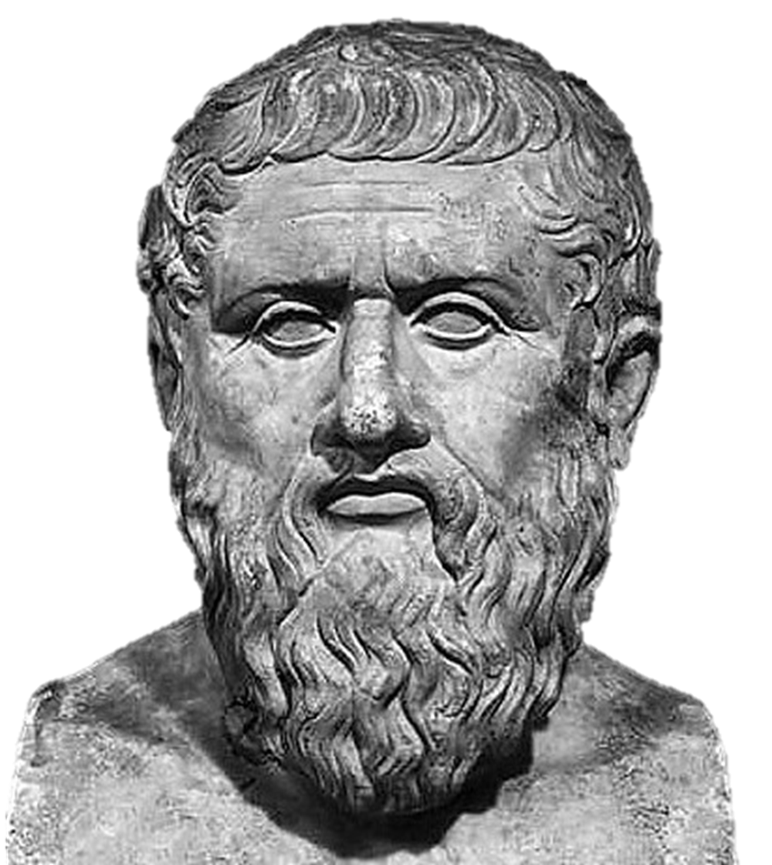

“Laws are partly formed for the sake of good men, in order to instruct them how they may live on friendly terms with one another, and partly for the sake of those who refuse to be instructed, whose spirit cannot be subdued, or softened, or hindered from plunging into evil.”
- Plato
What does Plato believe the purpose of government is?
Notes:
Open to various responses but he states that it should show good people how to be friendly with each other and to protect them from bad people.

Slide 12


20. A freeman shall not be amerced (fined) for a slight offense, except in accordance with the degree of the offense; and for a grave offense he shall be amerced in accordance with the gravity of the offense…none of the aforesaid amercements shall be imposed except by the oath of honest men of the neighborhood.
An excerpt from the Magna Carta, agreed to in 1215 by King John of England and a group of angry barons.
What was significant about the Magna Carta?
Based on this excerpt, what is one thing the barons were angry about?
Notes:
1) It limited the rights of the king. 2) They were likely angry about very high fines being imposed on minor offenses or that fines were imposed by dishonest men.

Slide 13

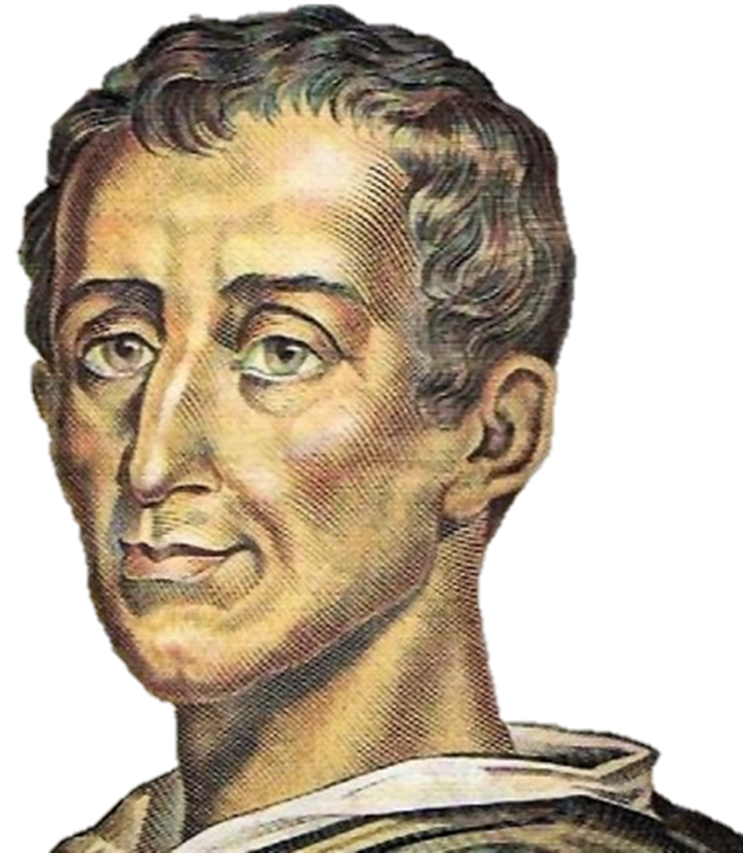
"Democratic and aristocratic states are not in their own nature free. Political liberty is to be found only in moderate governments; and even in these it is not always found. It is there only when there is no abuse of power. But constant experience shows us that every man invested with power is apt to abuse it, and to carry his authority as far as it will go."
- Montesquieu, The Spirit of the Laws
Enlightenment Quotes
What kind of governments allow the greatest liberty?
What historical problem does Montesquieu identify with governments?
Notes:
1) Political liberty is found in moderate governments. 2) That any man given power will abuse it as much as he can.

Slide 14


Imagine that you are on a cruise in the Pacific and crash near a tiny, uninhabited island. You and several hundred others begin building a community until you can be rescued. Do any laws apply? Explain.
Notes:
Answers will vary. However, while this is not a perfect analogy, I want students to imagine what it was like for those aboard the Mayflower. They landed so far from their original destination that the King's charter or patent didn't apply. To maintain order and establish a civil society, they wrote the Mayflower Compact before landing.

Slide 15

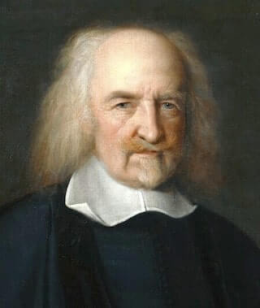
“[Life in a state of nature] is worst of all, continuall feare, and danger of violent death; And the life of man, solitary, poore, nasty, brutish, and short.”
- Thomas Hobbes, Leviathan (1651)
Hobbes is describing life without a strong central government. So, to him, what benefits does the government provide?
Notes:
Hobbes believed the government provides protection from war, crime, and violent death.

Slide 16

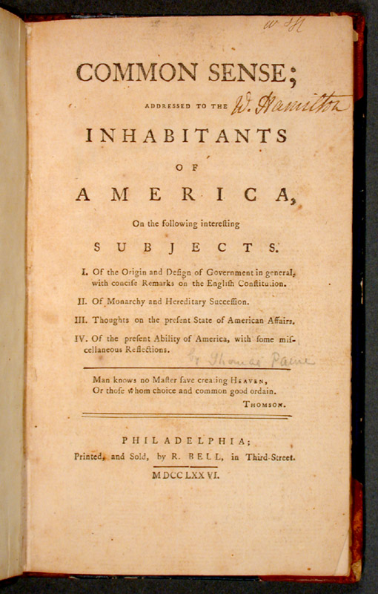
Common Sense was a short pamphlet written by Thomas Paine in 1775–1776 advocating independence from Great Britain for the 13 Colonies. Below is a small excerpt from it:
“For all men being originally equals, no one by birth could have the right to set up his own family in perpetual preference to all others forever, and tho' himself might deserve some decent degree of honours of his cotemporaries, yet his descendants might be far too unworthy to inherit them.”
What does Paine argue against in this excerpt?
Do you agree with his perspective? Explain.
Notes:
1) He argues against a hereditary monarchy like Great Britain’s because a ruler’s descendants might not be as worthy to rule as their ancestors. 2) Open to various student responses.

Slide 17

Fundamentals of Democracy
Citizen Participation
Equality
Political Tolerance
Accountability
Transparency
Regular Free And Fair Elections
Economic Freedom
Control Of The Abuse Of Power
Bill Of Rights
Accepting The Results Of Elections
Human Rights
A Multi-Party System
Rule Of Law
Democratic societies differ across the globe in many ways. However, some basic fundamentals and values are sometimes listed as essential to democratic government. A list of these is seen at the left.
Which principle do you think is most important in order for a democratic society to flourish and why?
Notes:
Student responses will vary.

Slide 18

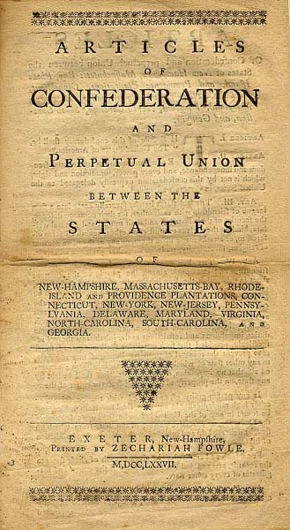
Based on the 13 Colonies' biggest complaints about Great Britain, what would you expect their new government to look like?
Notes:
Students' responses will vary. If they need a little help, I remind them of the taxes they despised and the King's power over them. Hopefully this gets them to thinking about a government with no power to tax, no head of state, and the other aspects of America’s Articles of Confederation.

Slide 19

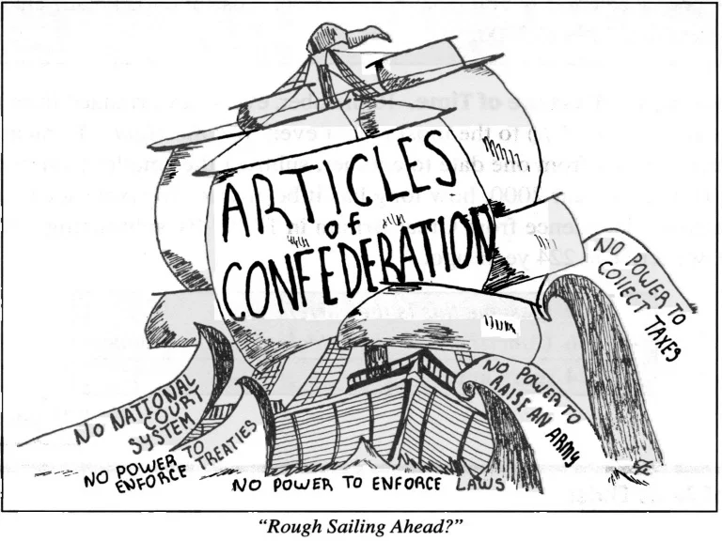
What was America’s 1st government?
What were some of its key weaknesses?
Why was it created this way?
Notes:
1-Articles of Confederation 2-no executive branch, no common currency 3-Founders were afraid of a powerful government/king like England’s

Slide 20


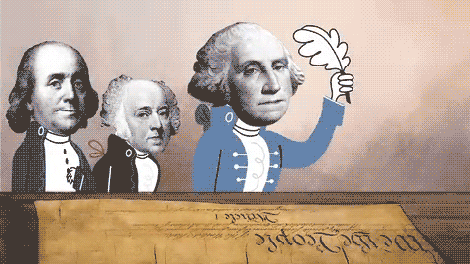
The Constitutional Convention took place in Philadelphia from May 25 to September 17, 1787. The original plan was to revise the Articles of Confederation. However, most attendees, including James Madison and Alexander Hamilton, pushed to create a new form of government. The delegates elected George Washington to be President of the convention. Madison put for the Virginia Plan as the first outline of government and took the lead on so much of the planning that he earned the nickname “Father of the Constitution”. The result of the convention was the creation of America's Constitution.
Describe the role of George Washington and James Madison at the Constitutional Convention.
Notes:
1) Washington was elected President of the Convention due to his leadership ability, but he remained out from most of the planning. Madison did much of the planning, including his Virginia Plan.

Slide 21


When the Constitutional Convention began, Edmund Randolph and James Madison put forward the Virginia Plan. This called for a government with three branches: legislative, executive, and judicial. The legislative branch would be made up of two houses, both based upon a state’s population.
Smaller states like Delaware and New Jersey objected to this, saying that large states would easily outvote them if the number of votes were based on population. They supported the New Jersey Plan with a single house legislature and equal representation.
The convention was deadlocked and appeared ready to fall apart when Roger Sherman proposed the “Great Compromise”. It called for a Congress with two houses: one based on population and the other with equal representation.
Which states likely supported the Virginia Plan and why?
How did the NJ Plan differ from the Virginia Plan?
How was this disagreement resolved?
Notes:
1) Larger states supported it because Congress was all based on each state’s population. 2) The NJ Plan had a single house legislature with equal representation. 3) The Great Compromise created 2 houses of Congress, one based on population and the other with equal representation.

Slide 22
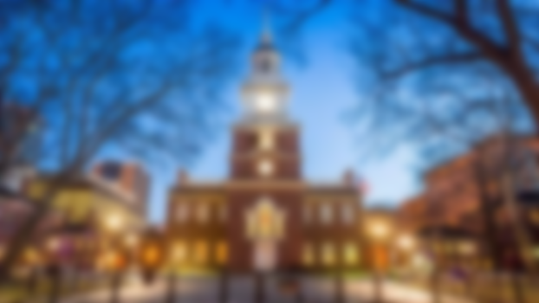

The Constitution established a government that shared power between the national and state governments, protected the rights of states, and provided a system for orderly change through amendments to the Constitution itself.
How can the Constitution be changed?
Why is it important to share power between the National government & states?
Notes:
1) Through Amendments 2) To maintain a balance of power

Slide 23
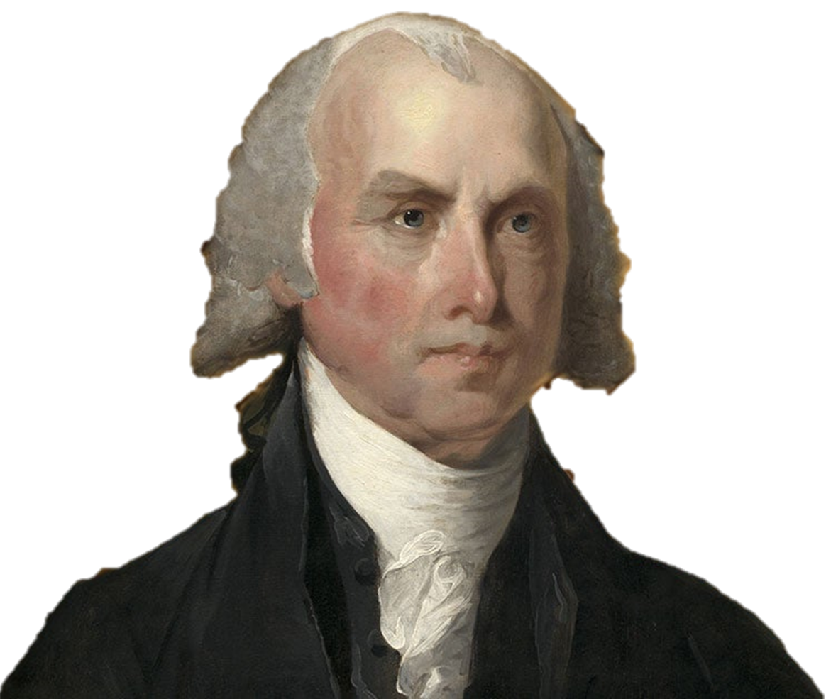

“If men were angels, no government would be necessary.”
-James Madison
Why does Madison believe governments are necessary?
Do you agree with him? Why or why not?
Notes:
1) People are flawed, and governments are needed to control society. 2) Open to students’ opinions

Slide 24

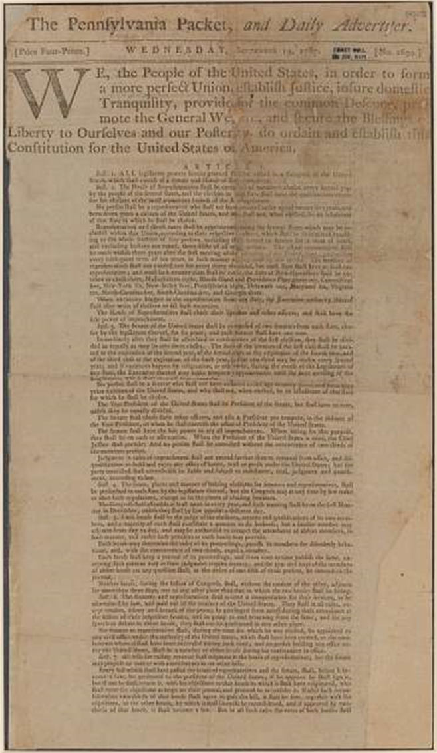
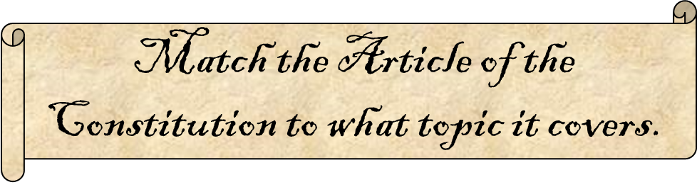
Article 1
Article 2
Article 3
Article 4
Article 5
The Judicial Branch
Amending the Constitution
The Legislative Branch
Relations among states
The Executive Branch
Notes:
1-Legislative 2-Executive 3-Judicial 4-States 5-Amendments

Slide 25

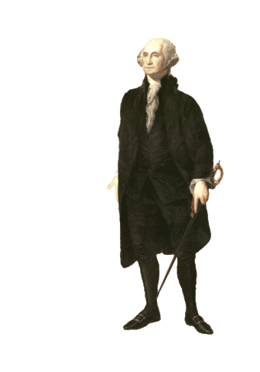
After the Constitution was ratified, The Electoral College elected Washington unanimously as the first president in 1789 and again in the 1792 election. He chose Jefferson and Hamilton to lead his first cabinet. John Adams, who came in 2nd in the election became the 1st Vice-President.
What political party did Washington belong to?
What were his group of advisors called?
How was the Vice President chosen then?
Notes:
1) None: Washington did not have a political party. 2) The Cabinet 3) Whoever came in 2nd in the election was the vice president.

Slide 26

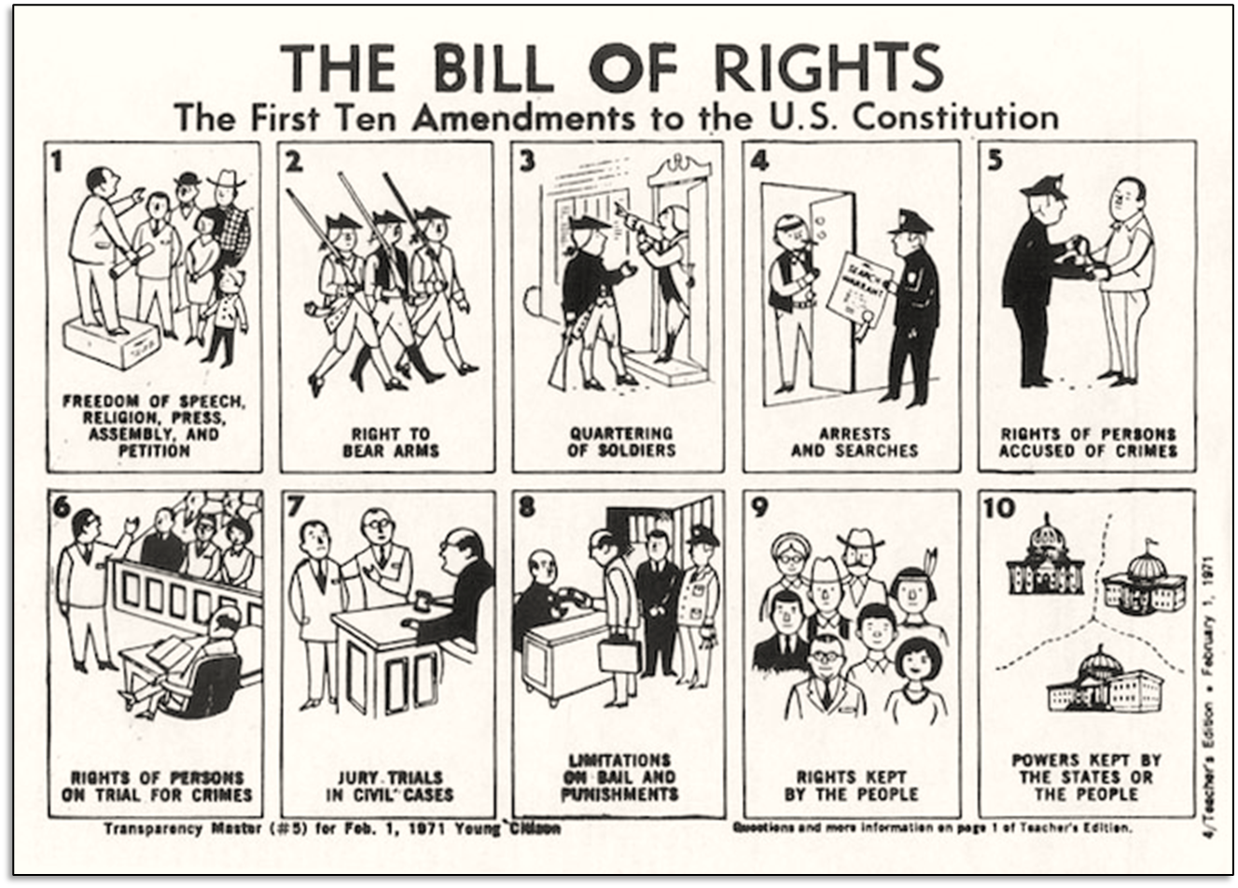
Which right from the first 10 Amendments do you think is the most important for you and why?
Notes:
After students think about their answer and write it in their notebooks, I ask students to share and start a brief discussion about these rights and where they come from.

Slide 27

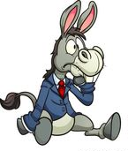

Do you consider yourself a conservative or a liberal and why?
Answer in a short paragraph.
Notes:
Answers will all vary for obvious reasons.

Slide 28


How closely do your beliefs align or contrast with those of your parents? Explain.
Notes:
This might be tough for those students who don't talk about news & events with their parents (actually, a good homework activity before this is to tell students to have a conversation about politics with their parents) but I ask them to do what they can.

Slide 29

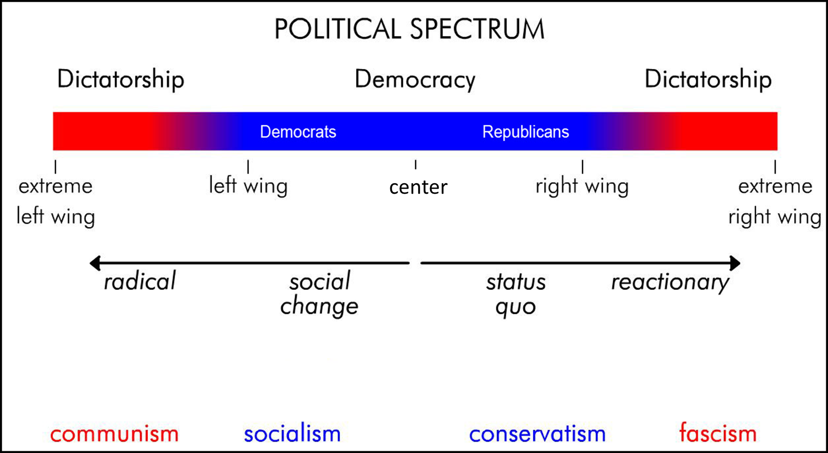
What does the political spectrum show?
Where do you think some current politicians fall along this spectrum?
Notes:
1) It shows different political positions in relation to one another from one extreme to another. 2) Responses will vary.

Slide 30

Reform Party Platform
Mission Statement The Reform Party of the United States of America will bring the will of the people and a voice of reason back to governance, and repair the long-term damage inflicted on our election processes, economy, world image, and fellow citizens’ daily lives over the past several generations.
ELECTION REFORM
The Reform Party will change the election and lawmaking policies and processes in such a way that it gives the voter direct access to those running for and elected to office.
GOVERNMENT AND ETHICS
The Reform Party expects and will demand only the highest ethical practices of our candidates and all elected officials.
SOCIAL ISSUES
The Reform Party takes NO STANCE as an organization on social issues such as pro-life/pro-choice and gay marriage.
An excerpt from the Reform Party’s platform is included to the right.
Do you see anything attractive in the Reform Party’s platform?
Why do you think 3rd parties like the Reform Party see so little support?

Slide 31


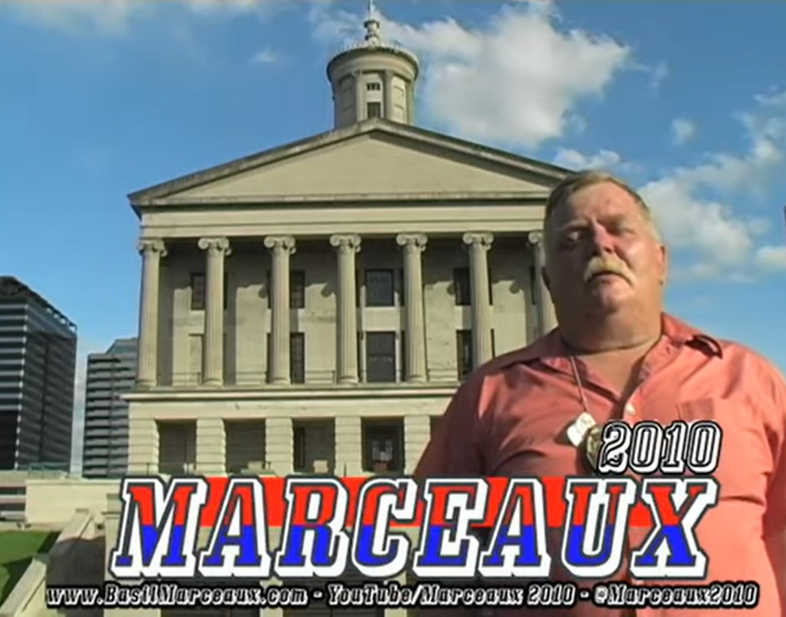
Describe political ads that you have seen. What is their usual tone, what do they show, etc?
Notes:
Responses will vary.

Slide 32
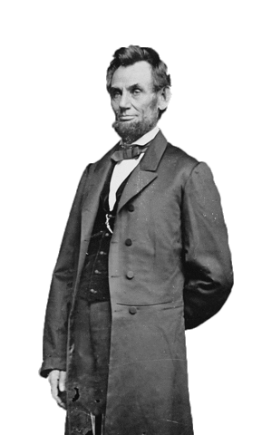

What characteristics make for the best politician?
Notes:
This questions is intended to be vague, so some students go the route of characteristics that help people get elected while others go with honesty, integrity, etc. It makes for a great class discussion to start class.

Slide 33

Following a tragic shooting, the National Rifle Association wants to run TV ads against a politician who supports expanding background checks for gun purchases.
Should they be allowed to?
Should there be a limit on how much they can spend?
Notes:
Student responses will vary. Info on the NRA PAC can be found here: https://www.opensecrets.org/political-action-committees-pacs/national-rifle-assn/C00053553/summary/2022

Slide 34


Whoever gets the most votes wins the presidency. Explain why this statement is either true or false.
Notes:
The statement is false because the electoral college vote determines the winner of presidential elections, not the overall vote total.

Slide 35

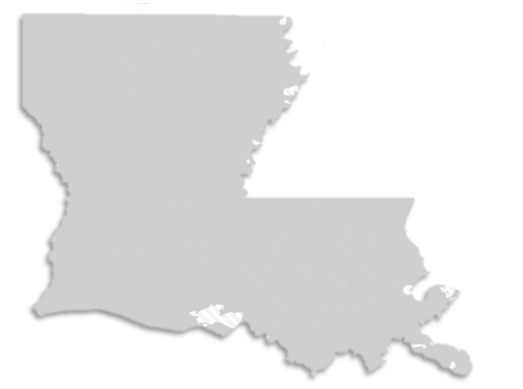
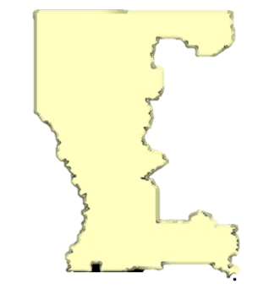
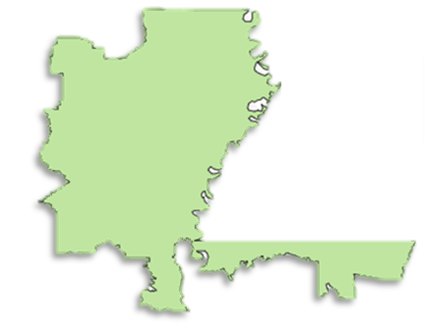
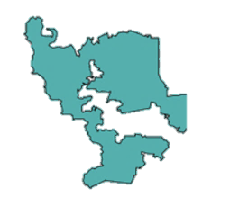
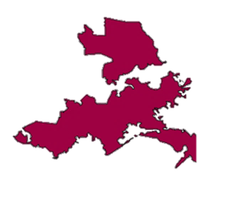
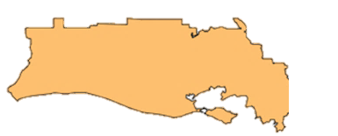
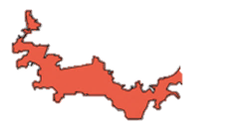
Gerrymandering is the manipulation of electoral district boundaries by politicians with the intent of creating an advantage for a party. This is usually done by “cracking” (diluting the voting power of the opposing party's supporters across many districts) or “packing” (concentrating the opposing party's voting power in one district to reduce their voting power in other districts).
Louisiana Legislative Districts
Why do you think Louisiana’s districts are shaped this way?
Do you think any of the districts are “packed” or “cracked” and why?
Notes:
Note: You can drag these districts around and take them off the map to have students drag-and-drop them or come up to the board to figure out how to put them together.
1) The 2022 map of Louisiana was drawn by the Republican-controlled state legislature. Their Democratic governor attempted to veto it but was overridden. 2) The legislature “packed” all the Democratic votes into the 2nd District (the small, long red one) which includes New Orleans and Baton Rouge.

Slide 36

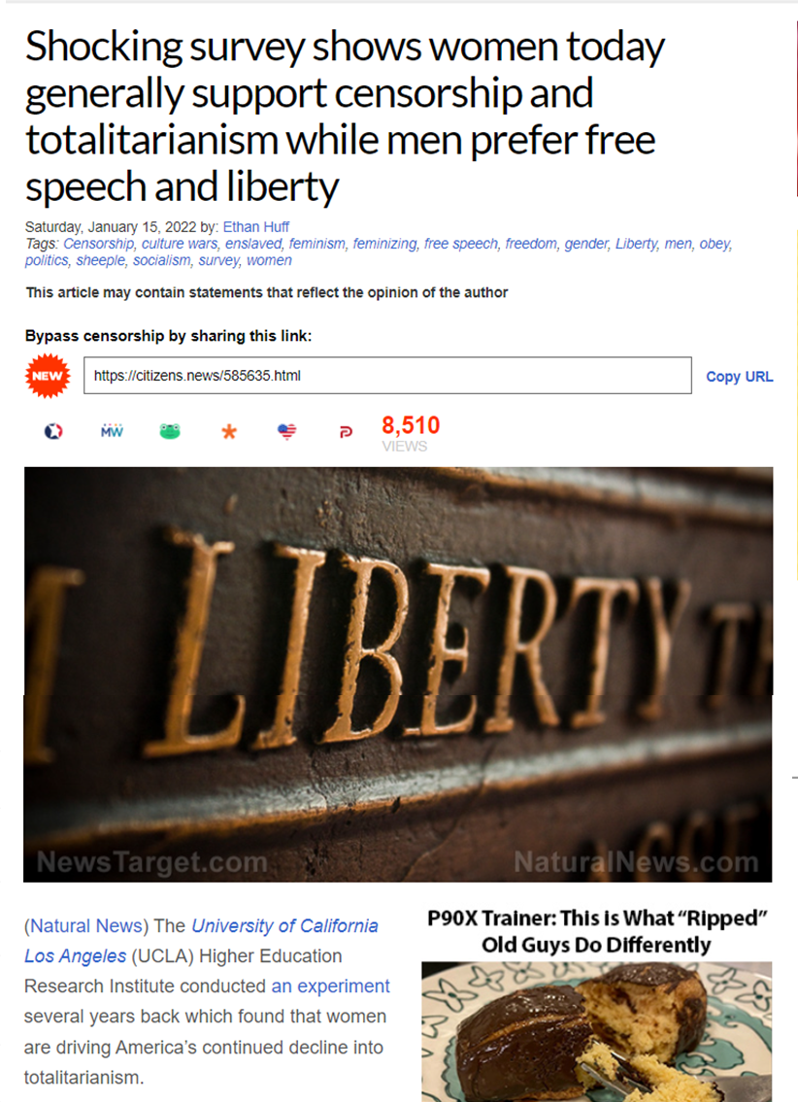

Where are you most likely to see “fake news”?
What are some ways you can identify something as “fake news”?
Notes:
1) Online and on social media. 2) Do a visual assessment of the site, identify the news outlet it is posted on, search for other articles on the topic, etc.

Slide 37

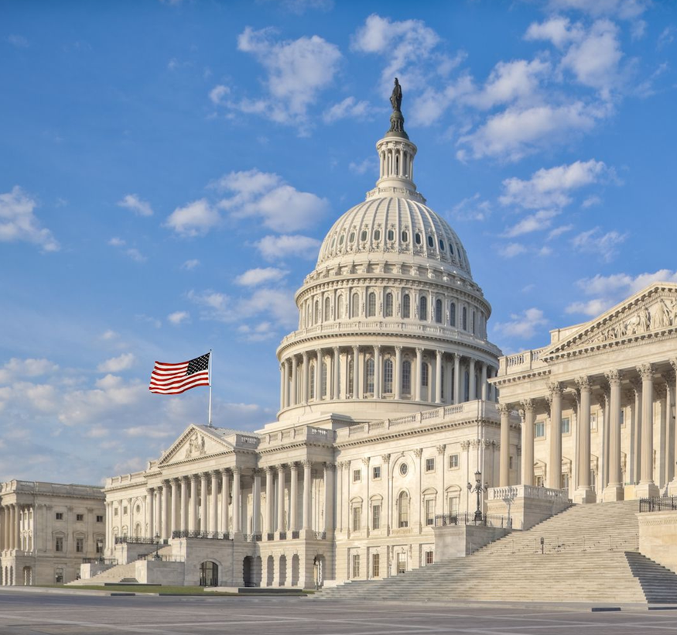
Since we've already introduced Congress in the Constitution unit, we’re going to start today with a “brain dump”!
Work with a partner to write down as many things about Congress as you can in 3 minutes.
Notes:
I make it a game and see who has the most at the end and ask them to share. Other students can challenge facts and I hold "veto" power.

Slide 38

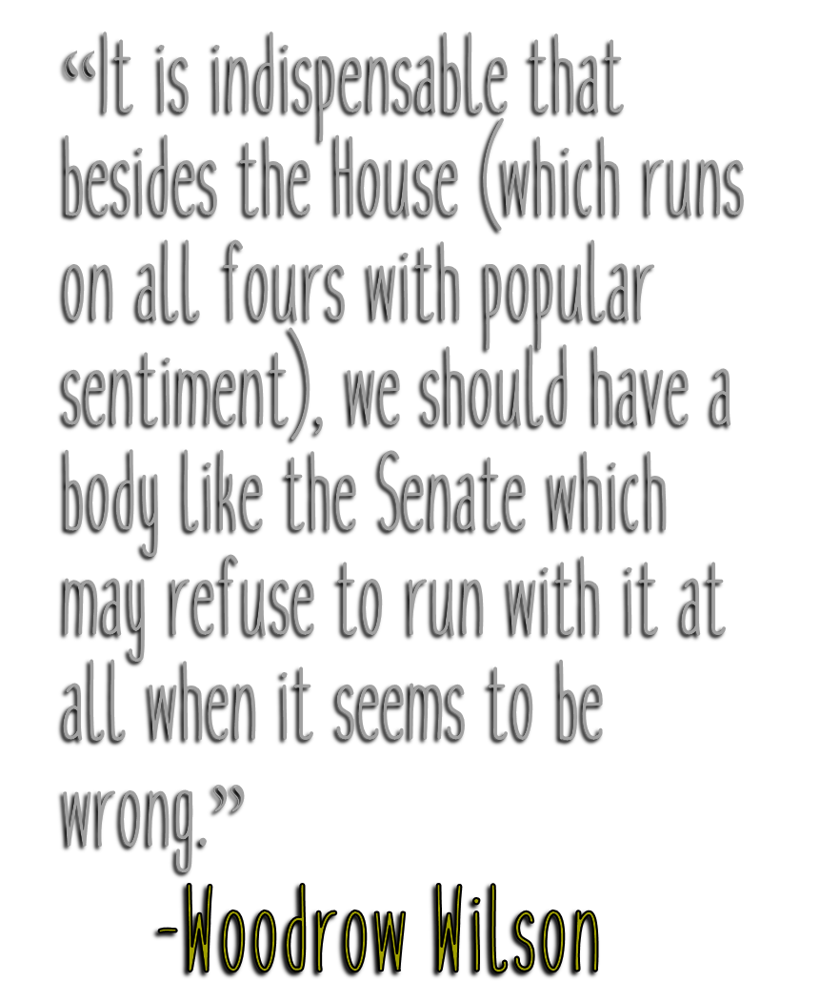
Indispensable: adj. Absolutely necessary; essential.
What does President Wilson mean by “popular sentiment”?
Is he speaking more highly of the Senate or House? Why?
Notes:
1) Popular sentiment is the will of the people at the moment, in that people can become excited about something but might soon move on to other issues. 2) He is complimenting the Senate and saying that House members get caught up in momentary issues that the Senate will take its time to review or might ignore.

Slide 39

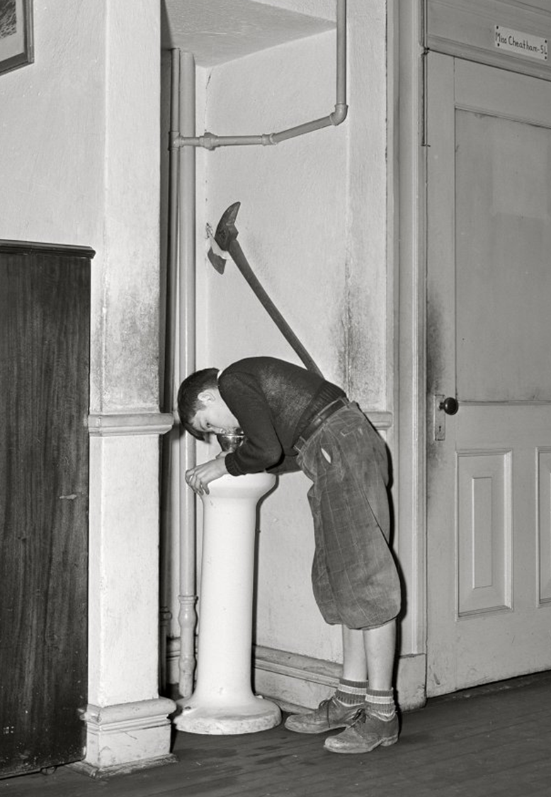
What is the “necessary and proper clause”?
How does this relate to “implied powers”?
What is an example of an implied power?
Notes:
As a warm up for the expressed/implied powers of Congress, it's fun to do the "Power to Get a Drink activity. For this you ask if anyone is thirsty and then tell a student they have the Expressed Power to Get a Drink. However, when they get up to leave, tell them, "Wait, I didn't give you permission to just leave the room whenever you want." When they balk at this, ask "Is it necessary to leave the room to get a drink?" You can carry this on a few more times (be in the hallway, not having a pass, etc) to reinforce the "necessary and proper" aspect of "implied powers". You can then have them answer these warm up questions.
1) Under Article I, Section 8 of the Constitution, Congress has the power "to make all Laws which shall be necessary and proper for carrying into Execution the foregoing Powers, and all other Powers vested by this Constitution. 2) Implied powers are political powers granted to the United States government that aren't explicitly stated in the Constitution.

Slide 40
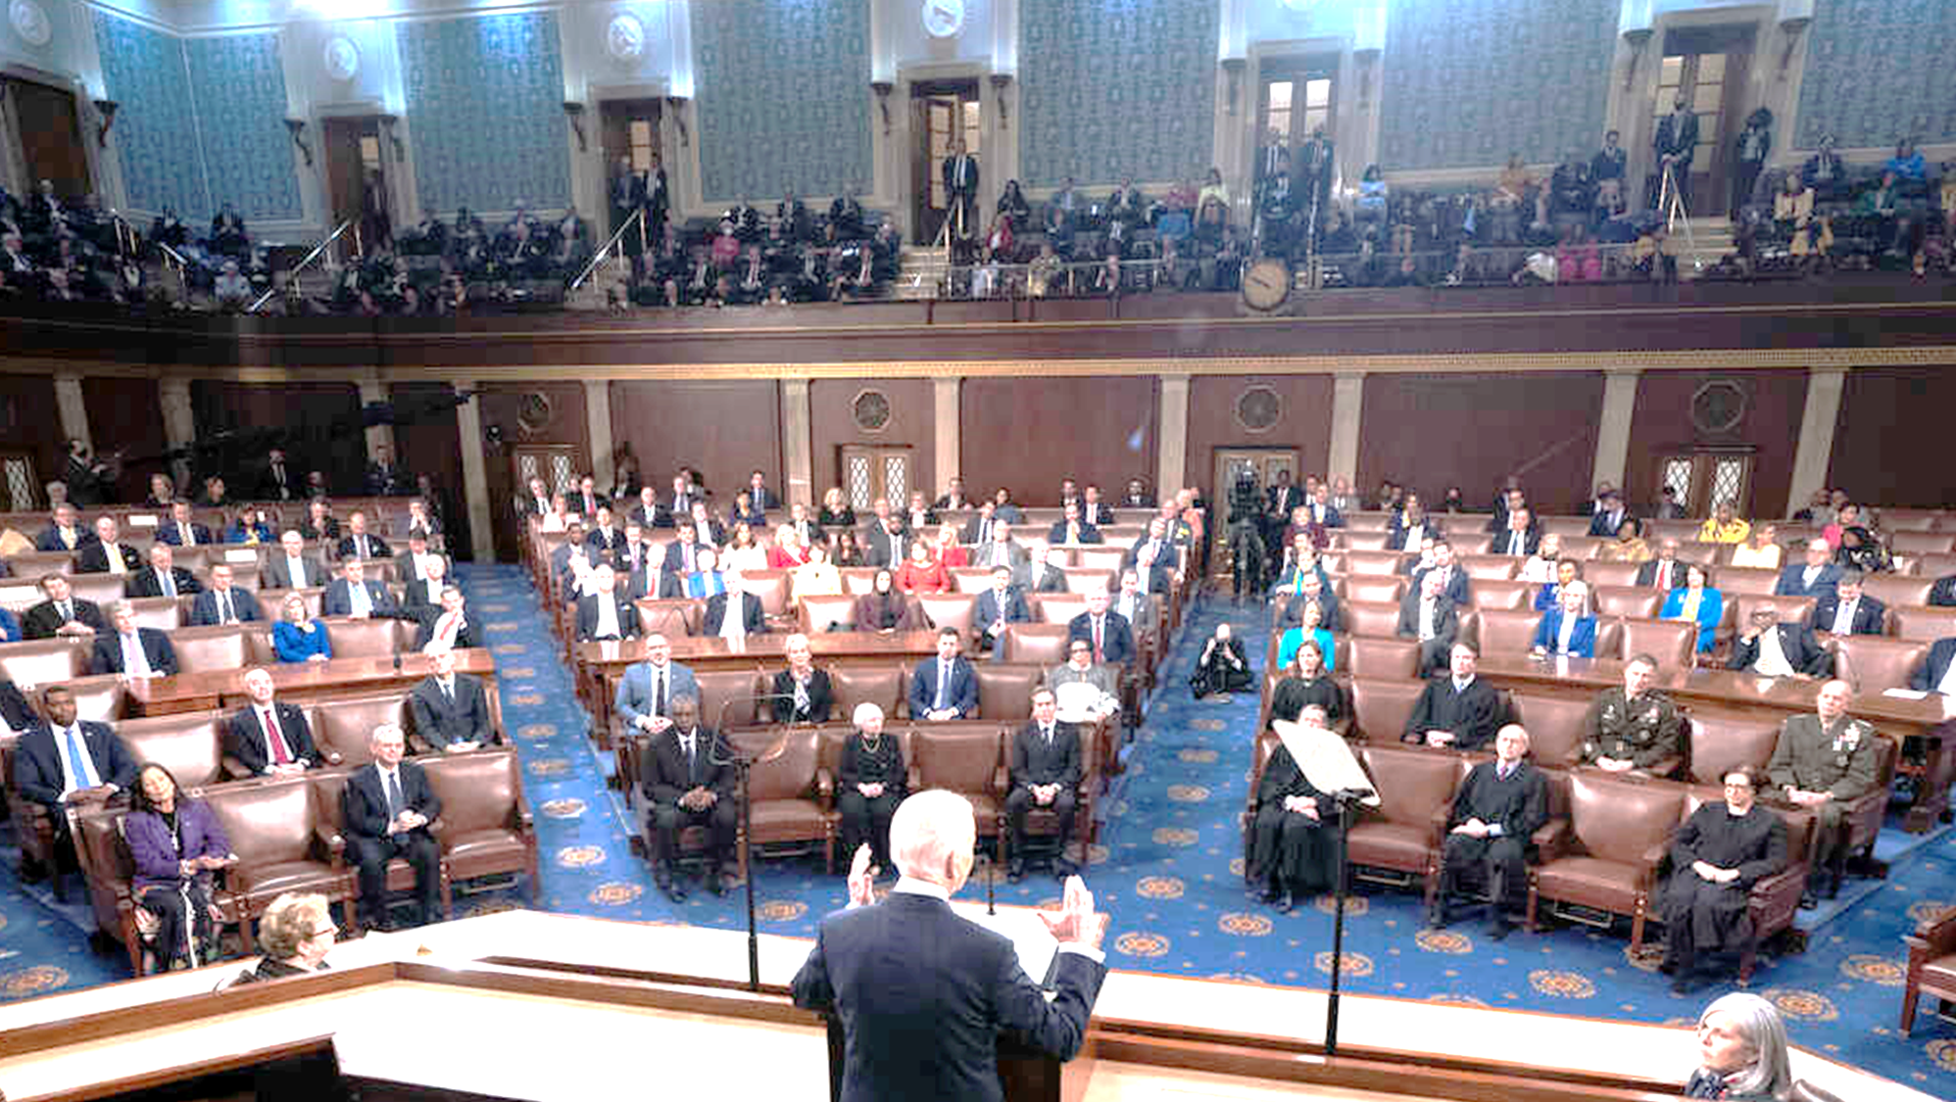

Think back to the analysis you did on Congressmen and their jobs/backgrounds.
Which jobs are most helpful for getting into government & why?
Which career backgrounds are lacking in Congress?
Notes:
1) Answers will vary but should include lawyers, business leaders, and white-collar professionals. 2) Open to student opinion but might include educators, or other jobs that students wish to see more focus on or respect for.

Slide 41

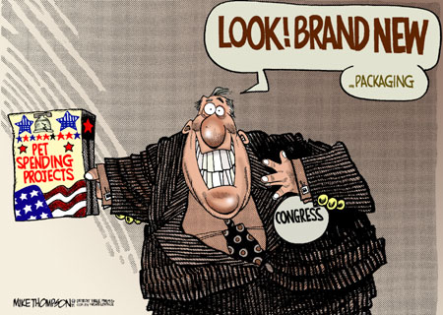
What is “pork barrel” spending?
What are some of the criteria for identifying spending as “pork”?
Why is often used to criticize Congress?
Notes:
1) Pork barrel is a metaphor for government spending on localized projects secured solely or primarily to bring money to a representative's district. 2) Citizens Against Government Waste outlines seven criteria by which spending can be classified as "pork":
Requested by only one chamber of Congress
Not specifically authorized
Not competitively awarded
Not requested by the President
Greatly exceeds the President's budget request or the previous year's funding
Not the subject of Congressional hearings
Serves only a local or special interest.
3) Open to various student responses.

Slide 42


What is something that you wished was a law? Or what is a current law that you wish didn't exist?
Notes:
Responses will obviously vary quite a bit. I give them a few minutes to think it over and respond. Go over them briefly, but it's helpful to have students save these thoughts for a later activity on how a bill becomes a law and how many steps a bill needs to go through to become a law.

Slide 43

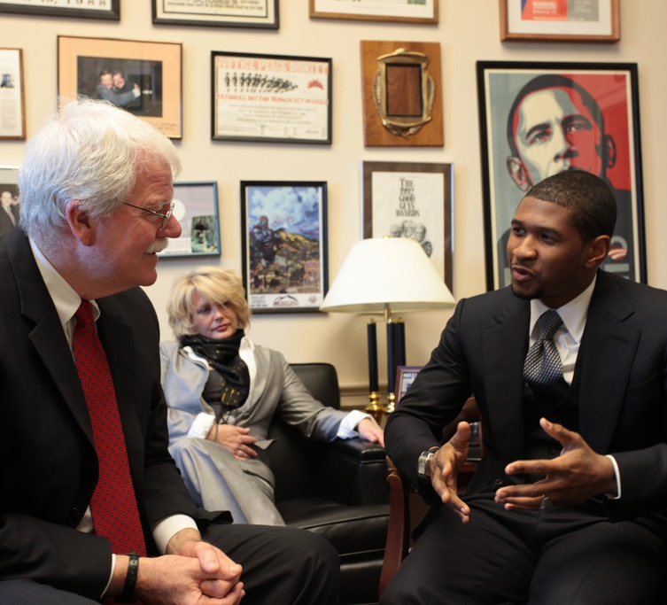
Place these steps of how a Bill becomes a law in the correct order.
Floor Action
Vote
Bill is Introduced
Presidential Action
Bill is Signed into Law
Conference Committees
Bill is Drafted
Committee Action
Notes:
Bill is Drafted
Bill is Introduced
Committee Action
Floor Action
Vote
Conference Committees
Presidential Action
Bill is Signed into Law

Slide 44

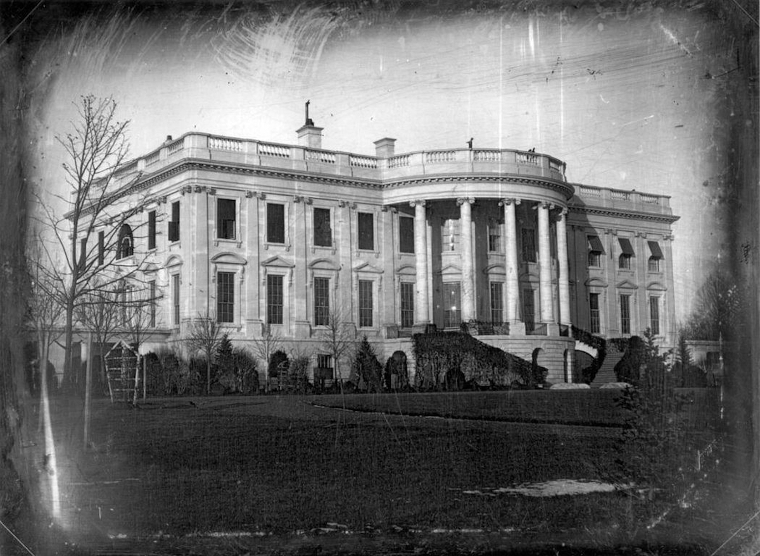
What article of the Constitution deals with the presidency?
What are some of the powers given to the President?
Notes:
1)Article 2) Answers will vary but can include veto power, command the armed forces, convene or adjourn Congress, grant pardons, and receive ambassadors.
Image: The White House in 1846 (the earliest known photo of it).

Slide 45
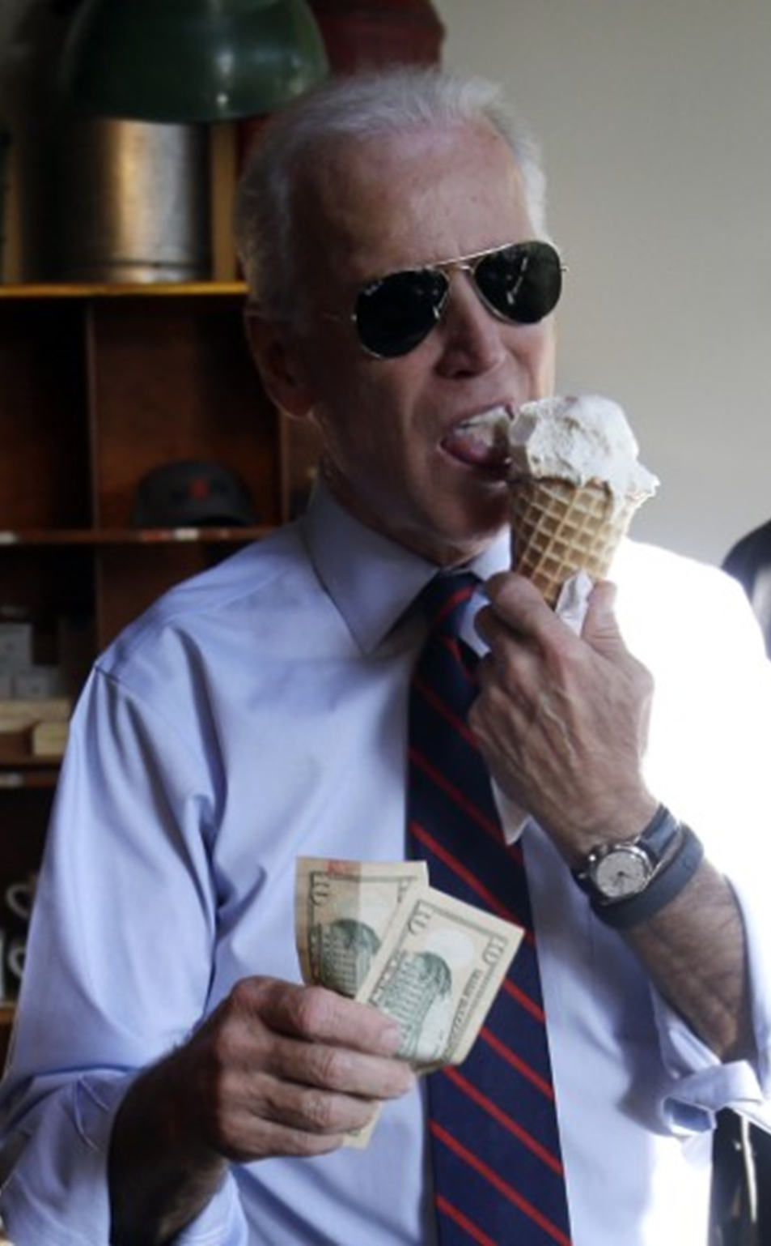

What are some of the President’s unofficial duties?
Notes:
Answers will vary but might include acting as le model for the country, serving as his party’s leader, representing the country at home or abroad.

Slide 46

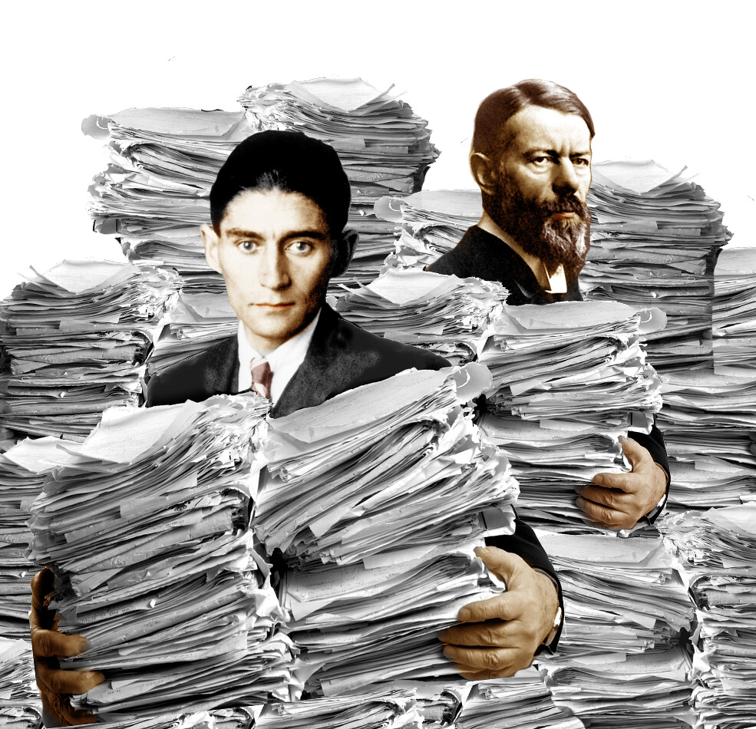
What is an experience you have had with government bureaucracy?
Notes:
This question will vary by age. If your students are old enough to have gotten a driver's license or learner's permit, that is a good one. Or even just trips to the post office can be good for younger kids or needing paperwork to enroll in school.

Slide 47


State Treasury Defense Justice Interior Agriculture Commerce Labor | Health & Human Services Housing & Urban Development Transportation Energy Education Veterans Affairs Homeland Security
For each, name the Cabinet department that would most likely be involved.
There’s a security issue at the US Border.
A massive protest begins outside the US Embassy in Jordan.
A debate is held on who should replace Jackson on the $20.
A mysterious illness is killing millions of fish in the Mississippi River.
Notes:
1) Homeland Security. 2) State Department. 3) Treasury Department. 4) Dept of the Interior

Slide 48

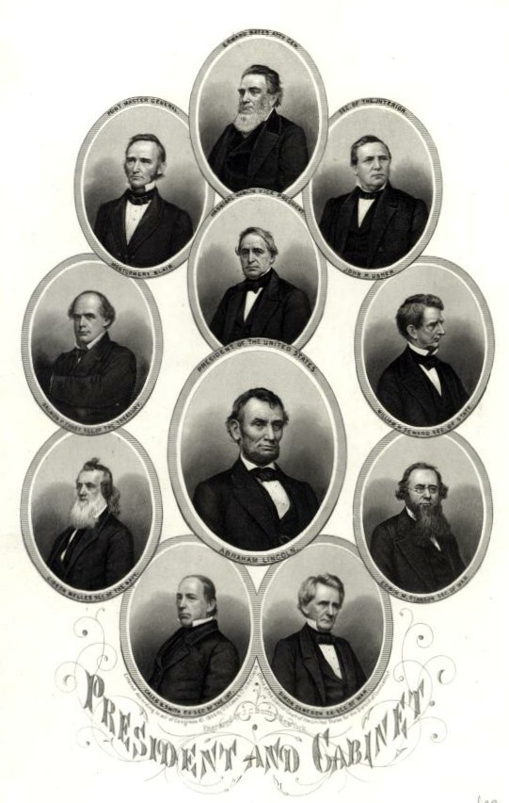
Should the members of a presidential team (VP & Cabinet) be better at taking & following orders or at asserting their expertise & opinions? Should they be lapdogs or tigers? Which is better for the President and the Country? Provide a specific reason for your response.
Notes:
Answers will vary for students.

Slide 49


As best you can, define the president’s current agenda and policies.
Notes:
Responses will obviously vary.

Slide 50


What does a “political scandal” mean?
What are some examples?
Notes:
1) a political scandal is an action or event involving government officials that is regarded as morally or legally wrong and causing general public outrage. 2) Many possible responses including Clinton-Lewinski scandal, Watergate, Trump’s call to Ukraine, etc

Slide 51
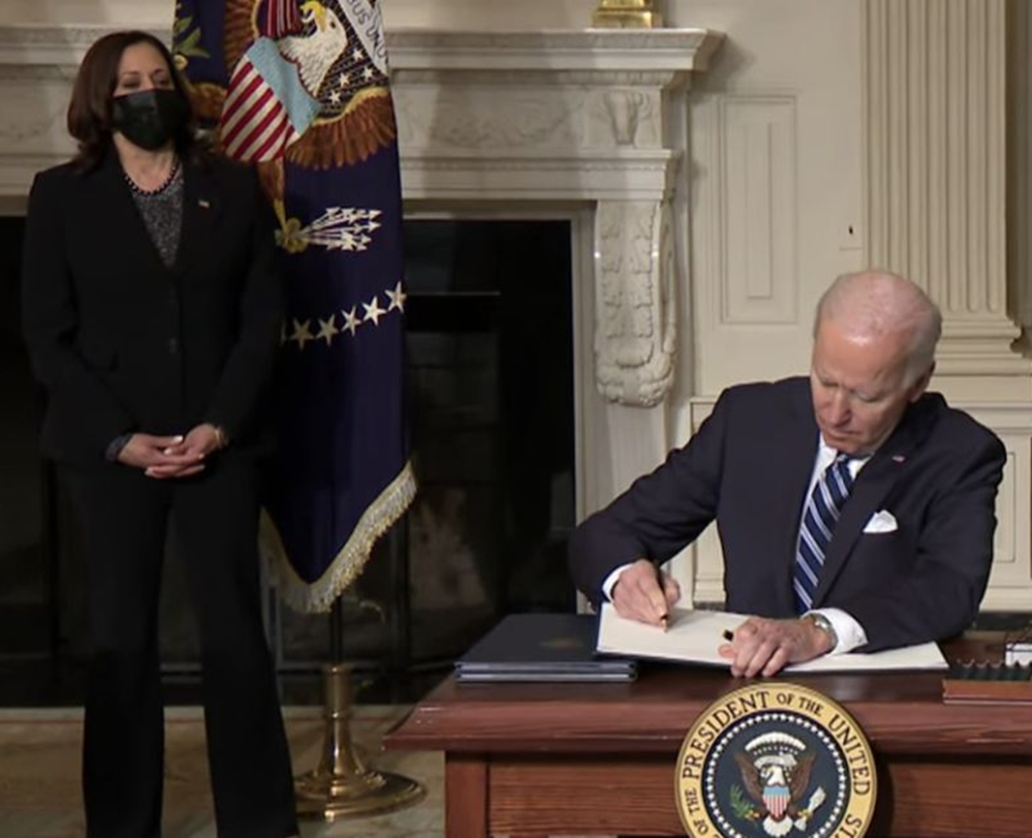

Is any way for a law to be passed in the US without Congress?
Notes:
Kind of a trick question designed to spark debate. While an executive order is not a law (laws must be passed by Congress and signed by the president), they have the force of a law and must be carried out.

Slide 52

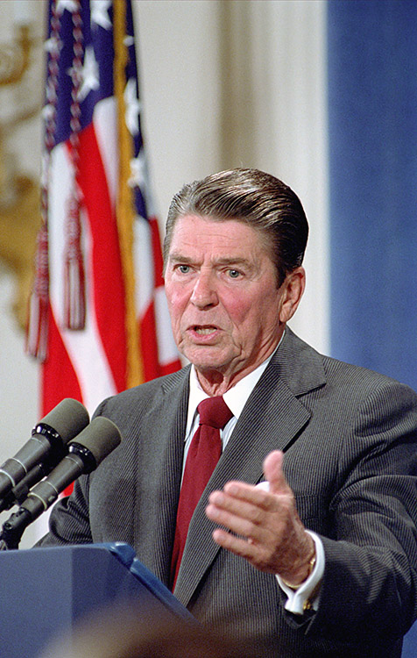
In August 1986, President Reagan gave a speech on how America’s government tends to be inefficient. In it, he gave a now-famous quote:
“The top 9 most terrifying words in the English Language are: I'm from the government, and I'm here to help.”
What policies can presidents like Reagan promote when they have this belief?
Can you think of an example where this quote would ring true and one in which it would not?
Notes:
1) This view expresses the need for a smaller form of government with tax cuts, reducing government programs, and promoting privatization. 2) Open to many possible responses of government programs going poorly and then some that work well and help people.

Slide 53
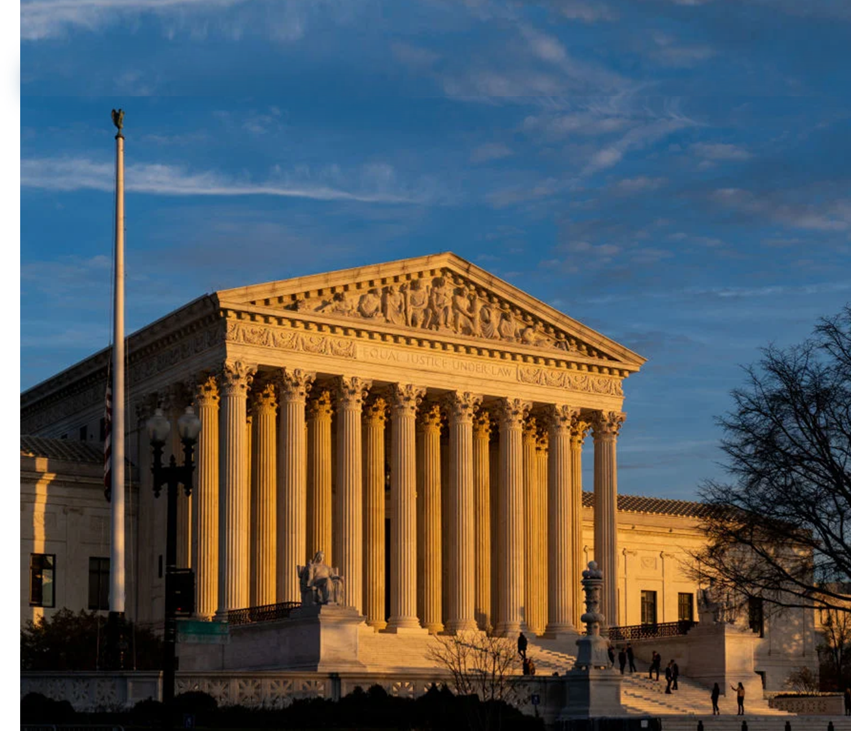

Describe how a case gets to the Supreme Court.
What are some Supreme Court cases?
Notes:
1) Several ways: an appeal is issued by a lower court (state or appeals court) and it is selected to be heard by the Supreme Court (4/9 justices select it) or it can come through original jurisdiction (e.g. disputed between states). 2) Many possible responses: Brown v. Board, Roe v. Wade, Obergefell v. Hodges, etc.

Slide 54


What political powers does the Supreme Court hold?
How do these compare to the other 2 branches. Is it their equal? The least or most powerful? s
Notes:
1) Judicial review and declare a Legislative or Executive act in violation of the Constitution. Interpret the Law as it is written, etc. 2) Open to various student opinions.

Slide 55


What is the difference between criminal court and civil court?
What is the difference between a misdemeanor and a felony?
Notes:
1) Criminal: you’ve committed a crime, Civil: You have somehow caused harm, or violated someone’s rights. 2) Misdemeanors are smaller crimes while felonies are worse.

Slide 56


“Never forget that justice is what love looks like in public.”
Cornell West
Reflect on this quote compared to traditional ideas of justice and revenge.
Notes:
Open to various student responses. The general idea is that justice includes being compassionate, forgiveness, and wanting justice for innocent people. Traditionally justice was about revenge “an eye for an eye”.

Slide 57


Name a court decision that changed America for the better and why/how it did.
Notes:
1) Answers can vary but might include Brown v. Board, Loving v. VA, etc. When you discuss their responses, see who named a case which could be considered an "activist" decision and explain what that means.

Slide 58

Read the quote and reflect on why Urbina might believe that the reality of America’s justice system differs from the truth?
“At the heart of the American paradigm is the perception that law and its agents . . . police officers, correctional officers, attorneys and judges . . . are color-blind and thus justice is impartial, objective and seeks la verdad (the truth). But, la realidad (reality) differs.”
― Martin Guevara Urbina, Latino Police Officers in the United States: An Examination of Emerging Trends and Issues
Notes:
Student responses will vary. Urbina is a Mexican-born American researcher & professor who spent 20 years examining race relations, capital punishment, law, and justice. A “paradigm” is an example or model.

Slide 59

Name a government topic that most interests you and briefly explain why.
Notes:
I use student responses for this warmup to assign them a landmark court case to research and create a project on. There are 30 famous court cases listed in the PBL assignment description and 25 of them included on the graphic organizer. I usually use the first 25 because the last 5 are cases we already study elsewhere in the course.

Slide 60


How do your rights as a student in this school differ from the rights of others in the public who might be accused of a crime?
Notes:
The court declared in Tinker v. Des Moines that students and teachers do not “shed their constitutional rights to freedom of speech or expression at the schoolhouse gate.” The First Amendment ensures that students cannot be punished for exercising free speech rights, even if school administrators don't approve of what they are saying. However, speech cannot disrupt school activities. Schools can also have dress codes and are allowed to search student lockers and bags without needing a warrant.

Slide 61


Brain Dump! List as many Civil Liberties as you can think of that are guaranteed by the Constitution.
Notes:
I like using sticky notes that they grab on the way in the room, then they have 5 minutes to get theirs posted up on the board. The Google Classroom question/discussion feature is also good for this if your students have devices ready. Answers include rights to: free speech, free exercise of religion, and to freely assemble, be free of unreasonable searches and seizures, a speedy trial, by an impartial jury, the right to confront witnesses, etc.

Slide 62

What is the one right in America that you feel is most “truly fundamental to our notions of liberty” and why?
Notes:
* Quotes are included because only rights that are truly fundamental to our notions of liberty and justice that cannot be denied without compelling reason are subject to the Due Process Clause.

Slide 63


Explain the concept of the “Constitutional Floor” & give an example.
Notes:
States and local laws to protect civil liberties can be more protective of rights than the Constitution, but not less protective. This is known as the “constitutional floor” because it represents the lowest possible protection. An easy example is the federal minimum wage, where states can go higher but not lower.

Slide 64


We’ve learned that quiet isn’t always peace,
And the norms and notions of what ‘just is’
Isn’t always justice.
And yet the dawn is ours before we knew it,
Somehow, we do it.
Somehow, we’ve weathered and witnessed
A nation that isn’t broken, but simply unfinished.
We, the successors of a country and a time
where a skinny Black girl, descended from slaves
and raised by a single mother,
can dream of becoming president
only to find herself reciting for one.”
― Amanda Gorman, “The Hill We Climb”
In what way do you think America is “unfinished” as Gorman described?
Notes:
Open to many possible student responses.

Slide 65


What are some limits on freedom of speech in America?
How come Twitter can limit speech and ban people from the platform?
Notes:
1) Answers will vary. You cannot publish lies that destroy someone’s reputation and claim that freedom of speech protects you from a lawsuit. 2) Twitter is a corporation and not a government agency. Social media platforms are allowed to remove offending content when done in accordance with their stated policies

Slide 66


What is a First Amendment freedom that you feel could be threatened or challenged in America today or in the future and why?
Notes:
Responses will vary.

Slide 67


“Many forms of Government have been tried and will be tried in this world. No one pretends that democracy is perfect or all-wise. Indeed, it has been said that democracy is the worst form of government, except for all those other forms that have been tried from time to time.”
- Winston Churchill (1947)
Is Churchill critical of democracy? Would he prefer a different form of government?
Notes:
Churchill was likely cynical because British people voted him out from his position as Prime Minister within months of winning the Second World War. However, despite any flaws democracy has, it is still better than autocracy, communism, dictatorships, etc.

Slide 68


Rank the top 5 foreign policy issues facing the United States right now.
Notes:
If students need a little help getting started, you can provide a list (refugees, migration, cybersecurity, terrorism, climate change, human trafficking, Energy, Drugs, AIDS/Health, etc).

Slide 69


Which previous American president's foreign policy stance would be most effective in today's world and which would be least effective?
Notes:
Answers will vary.

Slide 70


What is “diplomatic immunity”?
What do you think the purpose of it is?
US Ambassador to New Zealand Scott Brown welcomed on 2017 introductory trip to the Cook Islands.
Notes:
1_ Diplomats are free from prosecution under the laws of the countries that host them. 2) The stated purpose of diplomatic immunity is to facilitate safe passage of diplomats and promote amicable foreign relations between governments, particularly during times of disagreement or armed conflict

Slide 71


What do “first world problems” mean?
What are some examples of problems from the developing world?

Slide 72


What is the message of this political cartoon?
How can giving aid to another nation also benefit the US?
Notes:
1) Isolationists are against aid to Europe because they don’t see how the US is connected and this will also help America. 2) Open to various responses, but there is the “rising tide raises all boats” analogy. If US aid goes to impoverished nations, they might improve, send less migrants to the US, buy more American-made goods, produce more goods for trade, etc.

Slide 73


Alexis de Tocqueville (1805 – 1859) was a French aristocrat who authored the 2-volume Democracy in America after his travels across the United States.
“Democracy extends the sphere of individual freedom, socialism restricts it. Democracy and socialism have nothing in common but one word: equality. But notice the difference: while democracy seeks equality in liberty, socialism seeks equality in restraint and servitude.”
Alexis de Tocqueville
How does democracy seek equality in liberty?
What is de Tocqueville’s criticism of socialism? Is it accurate?
Notes:
1) In a democracy, everyone has an equal vote and equal voice. 2) That is restrains people and makes them servants of the government. Responses will vary.

Slide 74


Briefly define each of these forms of government.
Autocracy
Oligarchy
Unitary government
Federal government
Confederation
Presidential government
Parliamentary government
Notes:
Picture: A young voter shows with pride proof she took part in Egypt's first widely contested presidential election, May 23, 2012.

Slide 75


* Anocracy is a form of government that is loosely defined as part democracy and part dictatorship
What are some reasons why the US might not be at the top of the polity score?
Notes:
1) Answers will vary but having just 2 political parties to choose from lowers its score for example.

Slide 76


Define “sprawl”.
What do you picture when you hear “suburban sprawl”?
Is this a part of our community? If not, where does it exist?
Notes:
Answers for each will vary but should describe unrestricted growth of housing and commercial development with little concern for urban planning.

Slide 77


How can voters change or add a new state law?
How are most new state laws created?
Notes:
1) Through signing a petition for it to go on the ballot. 2) They are proposed by the state legislature and voted on.

Slide 78

Where does a state case go if it is being appealed?
What is the difference between a justice of the peace and a magistrate?
Where are most misdemeanors heard?
Justices of the peace preside over minor offenses in rural areas
Magistrates handle minor civil complaints in urban areas
Municipal courts hear civil cases involving misdemeanors
Juvenile courts decide cases for individuals under age 18.
General trial courts try civil & criminal cases
Appellate courts courts of appeal between trial courts and State’s supreme court
State supreme courts review the decisions of lower courts
Notes:
1) First to an appellate court and then to the state supreme court. 2) Nothing really, just different regions with magistrates in more urban areas and justices of the peace in rural ones. 3) In municipal court.

Slide 79


How is our local government organized?
What services does it provide?
Notes:
* You might want to replace the picture with one of your town or city hall. Responses will clearly vary – it might be county government, town, township,

Slide 80



What is the difference between the “strong mayor” and “weak mayor” models?
What is a benefit of each model?
Mayor-Council Forms of Government
Notes:
1) The difference is in who selects the government administrators/department heads. 2) Open to various responses and will depend on the quality of the mayor, ability of town council to select dept heads, etc.

Slide 81

Why do you think education is the most expensive area?
Where do you think your local government could spend more money or save more money?
Notes:
1) Answers will vary but every child must go to school, whereas not everyone uses all the other services. 2) Answers will vary.

Slide 82


Write down 5 strengths of your community and five problems that you believe exist.
Notes:
Responses will vary. Have a class discussion on these and list them up on the board. Then talk about how the problems can be solved - who is responsible for them?

Slide 83


How do you think your community will change over the next 50 years?
What can the local government do to prepare for these changes?
Notes:
Answers will vary. Photo: Coral Gables, FL City Hall

